Slide 1
Section 0.2
“Before Calculus”: New Functions from Old

Slide 2
All graphics are attributed to:
Calculus,10/E by Howard Anton, Irl Bivens, and Stephen Davis
Copyright © 2009 by John Wiley & Sons, Inc. All rights reserved.

Slide 3
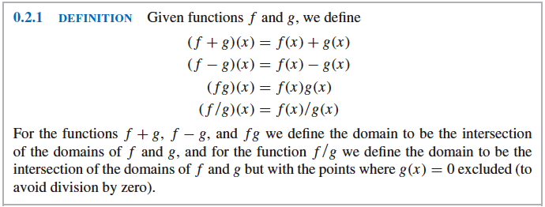
Arithmetic Operations on Functions
Just as numbers can be added, subtracted, multiplied, and divided to produce other numbers, so can functions.

Slide 4
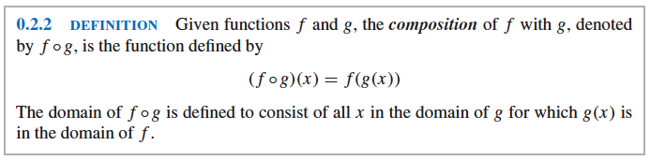
Composition of Functions
Perform composition of functions by substituting some function for the independent variable of another function.
There are different notations for this procedure.

Slide 5
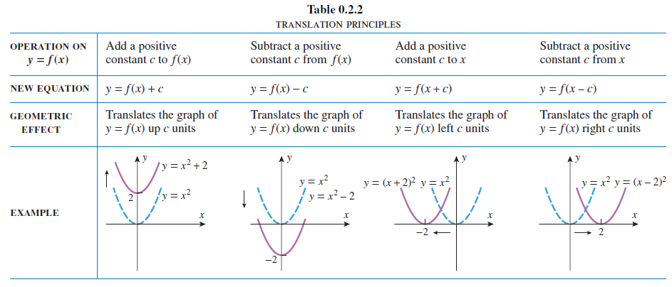
Example:
If f(x) = x + 2 and g(x) = x ², then f(g(x)) = x ² + 2 when you substitute the g(x) function into the f(x) function where x used to be.
You can graph the resulting function using the rules from Algebra II and PreCalculus:

Slide 6
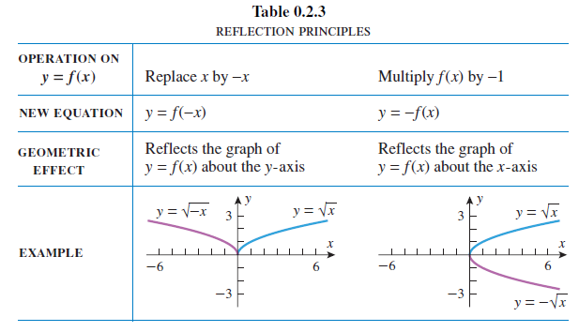
Reflections and Symmetry
The reflection principles in the following table will help you determine symmetry (memorize these rules f(-x) and –f(x) ) of graphs.

Slide 7
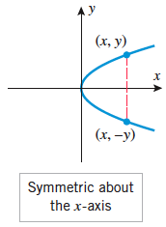
Symmetry about the x-axis
A graph is symmetric about the x-axis iff (if and only if) replacing y with –y in its equation produces an equivalent equation, f(x) = -f(x).
It may help to remember that –f(x) reflects a graph about the x-axis (upside down).

Slide 8
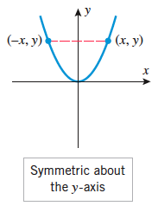
Symmetry about the y-axis
A graph is symmetric about the y-axis iff replacing x with –x in its equation produces an equivalent equation, f(x) = f(-x).
It may help to remember that f(-x) reflects a graph about the y-axis (opens to the other side).
This is called an even function. A few examples are y=ІxІ, y=x ², x ²+y ²=1

Slide 9
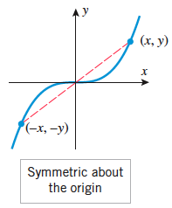
Symmetry about the origin
A graph is symmetric about the origin iff replacing both x with –x and y with –y in its equation produces an equivalent equation, f(x) = -f(-x).
This is called an odd function. A few examples are y=x, y=x ³, x ²+y ²=1

